Slide 1
Lecture 21 t Intervals and Sample Size

Slide 2
Would you board this plane?
An airplane maker’s study of its new passenger jet estimates the probability of a catastrophic in-flight failure. Your flight to the Bahamas is on one of these planes.
between 0.00012 and 0.0054 per flight
(1) Would you feel comfortable flying on this plane? Why or why not?
(2) If the maker could report this interval at 90%, 95% or 99% confidence,
which would you want them to use? Why?
(3) Would you feel differently if the interval were narrower but had a lower
confidence level?
0.00012 is 1 failure in 8,300 flights; 0.0054 is 1 in 185 flights
Airliners today: 1 fatal accident per 5.6 million flights (IATA, 2021–2025)
Even the best case is about 670 times riskier than a typical flight

Slide 3
Review
1 What does the confidence level C tell us?
The share of all intervals built this way that capture the parameter: 90%, 95%, 99%.
2 What is α?
The error rate, the share of intervals that miss: α = 1 − C. At 95%, α = 0.05, so 0.025 in each tail.
3 What is the critical value, and what does it do to the width?
z_{1−α/2}, the number of SEs in estimate ± z × SE. Higher C → bigger z → wider interval.

Slide 4
Data: a gene and a drug
Clopidogrel (Plavix), a blood thinner used after heart attacks and stents, is switched on by the liver enzyme CYP2C19. People with the CYP2C19*2 variant switch on less of it.
X = 1 if a person carries at least one copy of *2, and 0 otherwise
PERSON | POPULATION | GENOTYPE | COPIES OF *2 | X
HG00403 | Southern Han Chinese | G/G | 0 | 0
HG00404 | Southern Han Chinese | A/A | 2 | 1
HG00406 | Southern Han Chinese | G/A | 1 | 1
HG00407 | Southern Han Chinese | G/G | 0 | 0
HG00409 | Southern Han Chinese | G/G | 0 | 0
… | … | … | … | …
n = 504 East Asian participants of the 1000 Genomes Project, which sequenced 2,504 people worldwide to catalog human genetic variation

Slide 5
Example: carriers of CYP2C19*2
Estimate p, the proportion of all individuals of East Asian descent who carry the *2 variant.
277 of n = 504 people are carriers
(a) What is p̂? Is the check met? What is the standard error?
(b) What are the 90%, 95% and 99% confidence intervals for p?
(c) Can we say more than half of people carry *2?
(a) p̂ = 277 / 504 ≈ 0.550; 277 and 227 are both > 5
SE = √(0.550 × 0.450 / 504) ≈ 0.022
(b) 90%: 0.550 ± 1.645(0.022): 0.514 to 0.586
95%: 0.550 ± 1.960(0.022): 0.507 to 0.593
99%: 0.550 ± 2.576(0.022): 0.493 to 0.607
(c) At 90% and 95%, yes; the 99% interval includes 0.5

Slide 6
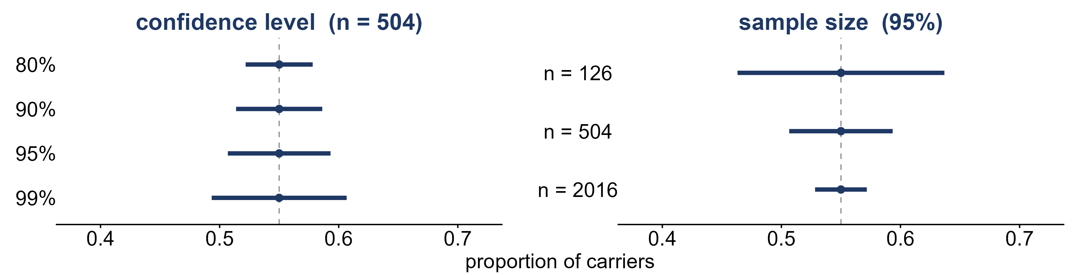
Making an interval narrower
The carrier interval (p̂ = 0.550) at four confidence levels, and at 95% with 4 times fewer or more people.
What happens to the width as C goes up? As n goes up?
Higher C → wider. 4 times the n → half the width (SE has √n on the bottom)

Slide 7
What if σ is unknown?
Every interval for μ so far used σ, the population standard deviation.
x̄ ± z σ / √n
(a) If we don’t know μ, do we know σ?
(b) What could we use in its place?
(a) Almost never
(b) s, the sample standard deviation: x̄ ± z s / √n. Does that still work?

Slide 8
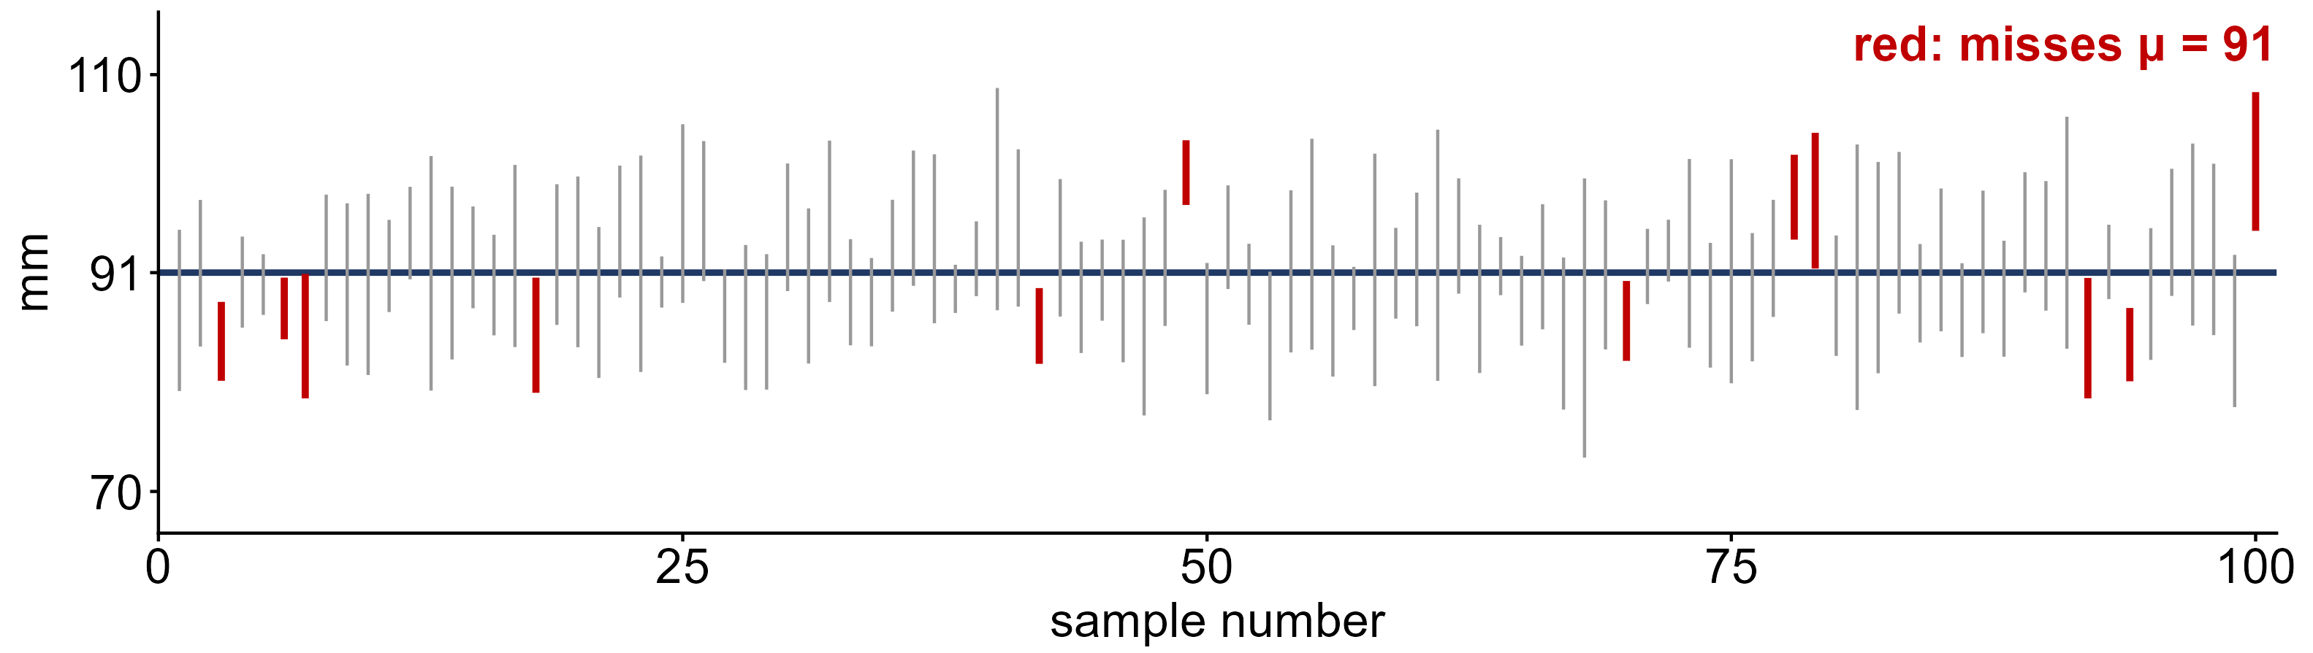
Does s in place of σ work?
Simulated: 100 samples of n = 5 whiskers from N(91, 8) mm; each line is x̄ ± 1.96 s / √5.
A 95% method should miss about 5 times. How many of these 100 miss μ?
12 of 100: s changes from sample to sample, so the intervals are too narrow too often

Slide 9
The t distribution
t distribution
a bell curve like N(0, 1) but with heavier tails; use it when s replaces σ
degrees of freedom
df = n − 1; the more df, the closer t is to N(0, 1)
t critical value t_{n−1, 1−α/2}
from the t-table row for df = n − 1; larger than z, so the interval is wider

Slide 10
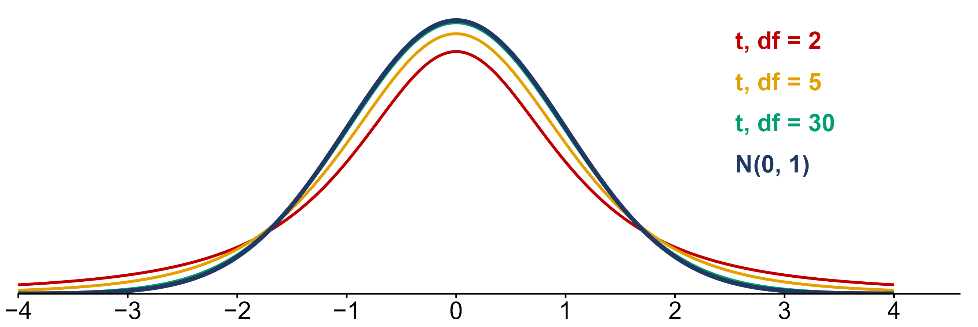
t versus the standard normal
Density curves of t with 2, 5 and 30 degrees of freedom, and the standard normal N(0, 1).
Which curve has the heaviest tails? What happens as df grows?
df = 2. As df grows, t approaches N(0, 1); by df = 30 they nearly match

Slide 11
Example: reading the t-table
In the course t-table, the row is df = n − 1 and the column is the confidence level.
95%, n = 10; 90%, n = 25; 99%, n = 10
(a) What is the t critical value for each?
(b) How does each compare with z for the same confidence level?
(a) df = 9: 2.262 df = 24: 1.711 df = 9: 3.250
(b) z = 1.960, 1.645, 2.576: t is always larger

Slide 12
Which interval?
a proportion p
p̂ ± z √(p̂(1 − p̂) / n), when np̂ > 5 and n(1 − p̂) > 5
a mean μ, σ known
x̄ ± z σ / √n
a mean μ, σ unknown
x̄ ± t s / √n, with df = n − 1
when the t interval works
the population is roughly normal, or n ≥ 30

Slide 13
Data: seal whiskers
Ginter et al. (2012) measured the longest undamaged whisker of 92 seals and sea lions from 11 species, to study how whisker shape evolved.
X = the total length of a seal’s longest whisker, in mm
SPECIES | SEALS (n) | MEAN LENGTH (mm) | SD (mm)
Harp seal | 16 | 80.6 | 10.8
Harbor seal | 15 | 86.5 | 10.5
Ringed seal | 16 | 79.6 | 10.9
Spotted seal | 9 | 91.2 | 7.9
Gray seal | 8 | 73.8 | 12.5
… | … | … | …
One whisker per seal; only each species’ n, mean and SD were published

Slide 14
Example: spotted seal whiskers
Estimate μ, the mean whisker length of all spotted seals, from the 9 that were measured.
n = 9; x̄ = 91.2 mm; s = 7.9 mm
(a) z or t? How many degrees of freedom?
(b) What is the standard error?
(c) What is the 95% confidence interval for μ?
(a) t, because σ is unknown; df = 9 − 1 = 8, t = 2.306
(b) 7.9 / √9 ≈ 2.63 mm
(c) 91.2 ± 2.306(2.63) = 91.2 ± 6.06: 85.1 to 97.3 mm

Slide 15
Data: watermelon citrulline
Korea’s national gene bank keeps seed of 100 watermelon varieties from around the world. Assefa et al. (2020) measured citrulline, the amino acid named after watermelon (Citrullus).
X = citrulline in a variety’s fruit flesh, in mg per g of dry weight
VARIETY | ORIGIN | CITRULLINE (mg/g)
IT120008 | Taiwan | 27.16
IT199814 | Kazakhstan | 25.83
IT203017 | Russia | 26.38
IT203029 | Kazakhstan | 24.01
IT203627 | unknown | 32.79
… | … | …
A random sample of n = 12 of the 100 gene-bank varieties

Slide 16
Example: citrulline, 90% and 99%
Estimate μ, the mean citrulline of all 100 gene-bank varieties, from the sample of 12.
n = 12; x̄ = 27.07 mg/g; s = 5.27 mg/g
(a) What are the degrees of freedom and the standard error?
(b) What are the 90% and 99% confidence intervals for μ?
(c) Which is wider, and why?
(a) df = 11; SE = 5.27 / √12 ≈ 1.52
(b) 90%: 27.07 ± 1.796(1.52): 24.34 to 29.80
99%: 27.07 ± 3.106(1.52): 22.35 to 31.79
(c) The 99% interval: more confidence needs a larger t

Slide 17
Choosing a sample size
margin of error m
the ± part of an interval: m = z × SE, so a larger n gives a smaller m
n for a proportion
n = z² p*(1 − p*) / m², with p* = 0.5 if there is no earlier guess
n for a mean
n = (z σ / m)², with σ from an earlier study
always round up
n = 59.1 means 60: rounding down misses the target m

Slide 18
Example: planning the next study
Before collecting data, decide how many to measure so the 95% interval is as narrow as you need.
carriers: m = 0.03, p* = 0.5; whiskers: m = 2 mm, σ ≈ 7.9 mm
(a) How many people for the proportion of *2 carriers?
(b) How many spotted seals for the mean whisker length?
(c) What happens to n if we want half the margin of error?
(a) 1.96² (0.5)(0.5) / 0.03² = 1067.1 → 1,068 people
(b) (1.96 × 7.9 / 2)² = 59.9 → 60 seals
(c) 4 times as large: m is squared on the bottom

Slide 19
What you should know
critical value z_{1−α/2}
1.645, 1.960, 2.576 for 90%, 95%, 99%; higher C → wider
σ unknown
use s and t with df = n − 1: x̄ ± t s / √n
width
wider for higher confidence; narrower for larger n
sample size
n = z² p*(1 − p*) / m² or (z σ / m)²; always round up

